Slide 1
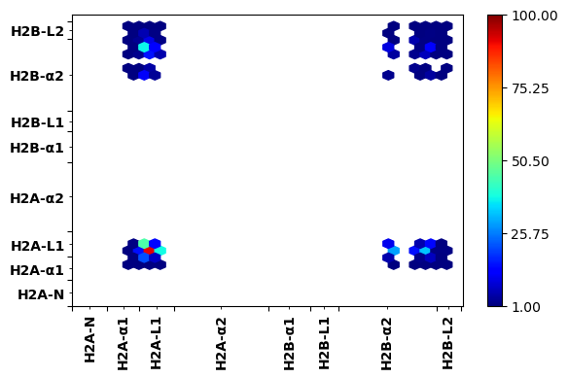
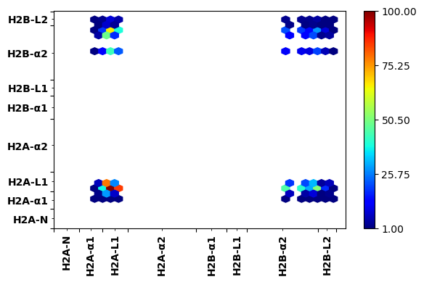
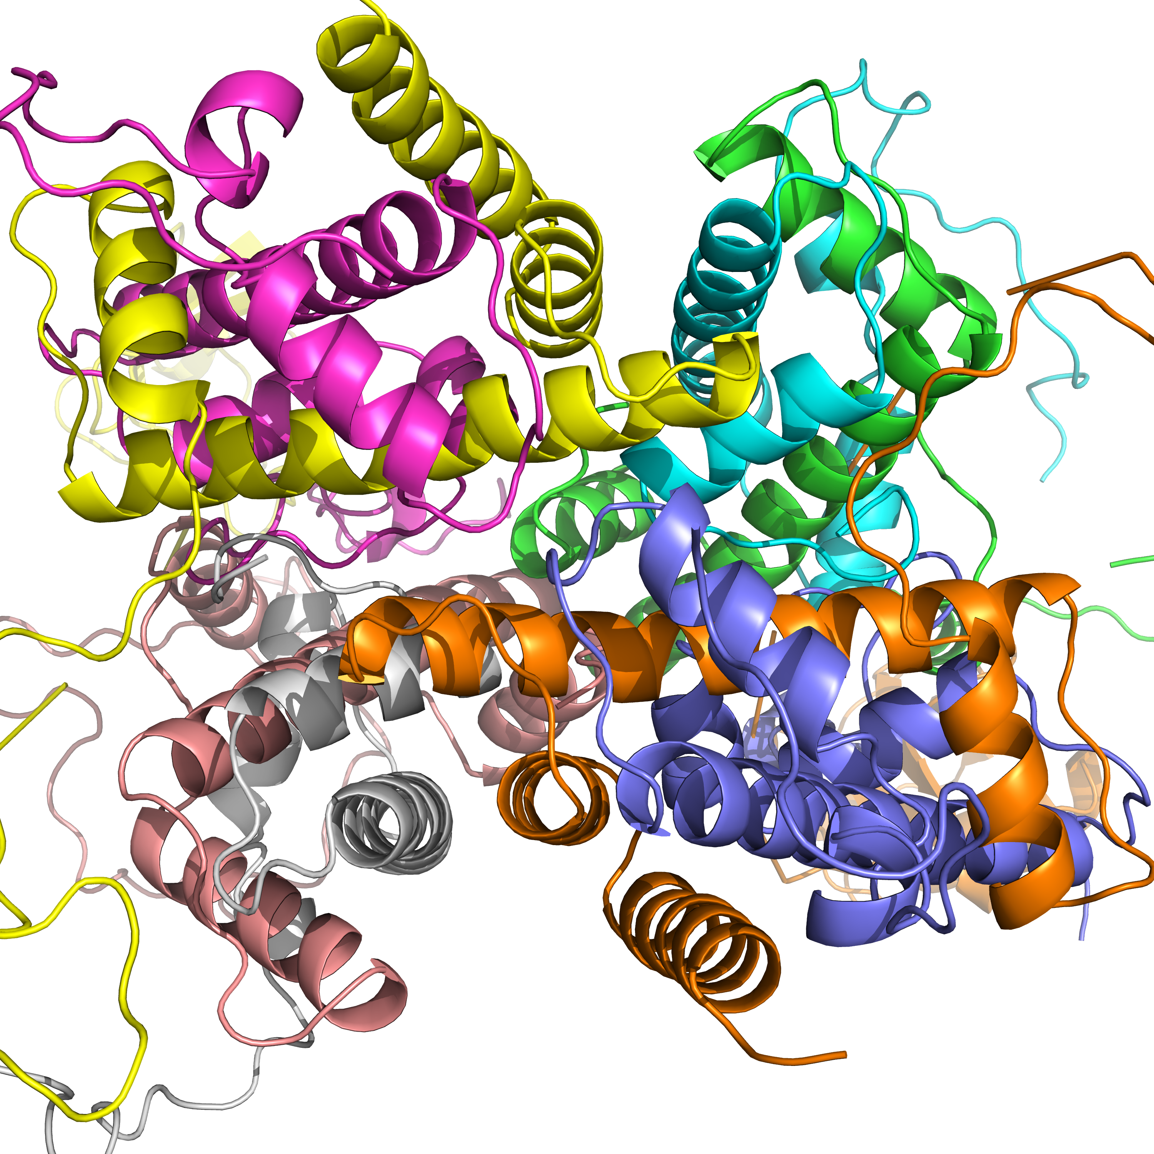
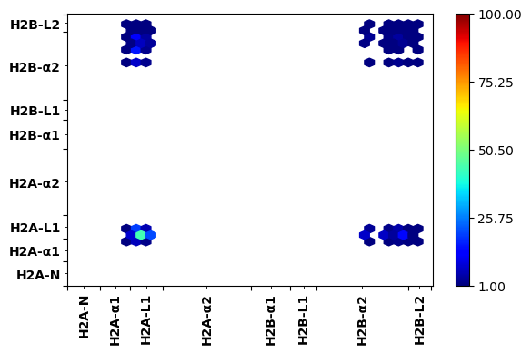
Canonical
H2AK119ub
# of contacts
L1-L1 magenta-purple
H2BK120ub
H2A/H2B dimer-dimer
interactions

Slide 3
Core-hexamer-dimer interaction energies in Kcal/mol
System Canonical H2AK119 H2BK120 | System | ΔE VDW | 𝝙Eelec | 𝝙E (Total)
 | Dimer 1 | -208.7±0.18 | 211.5±2.5 | 2.7±2.5
 | Dimer2 | -210.7±0.1 | 203.4±2.2 | -7.2±2.2
 | Dimer1 | -220.4±0.2 | 207.8±2.4 | -12.6±2.4
 | Dimer2 | -222.1±0.2 | 212.7±3.7 | -9.4±3.7
 | Dimer1 | -202.03±0.1 | 205.5±2.2 | 3.5±2.0
 | Dimer2 | -202.7±0.1 | 210±2.3 | 7.5±2.3
DNA not included
in the calculations

Slide 4
Tetramer-Dimer contacts
Dimer 1
H2AK119ub>Canonical>H2BK120ub
Dimer 2

Slide 5
Performed all the calculations on 2 microsecond trajectories.
Making final figures for the publication.
Testing whole dimer-hexamer and dimer-DNA binding (MMGBSA) including tails.

Slide 6
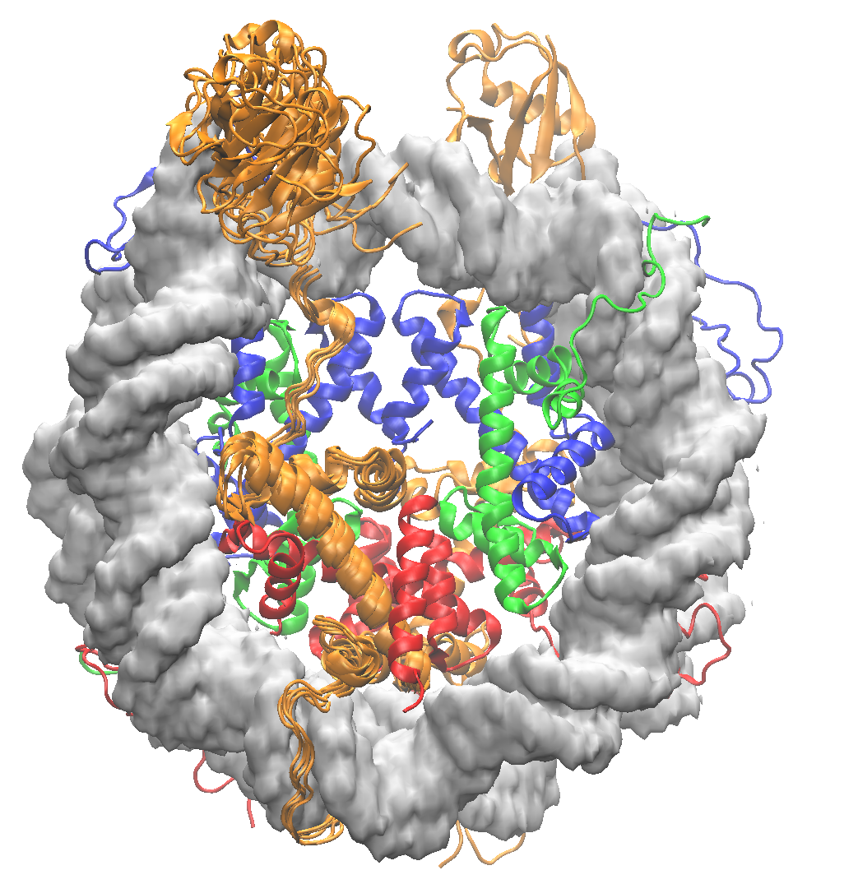
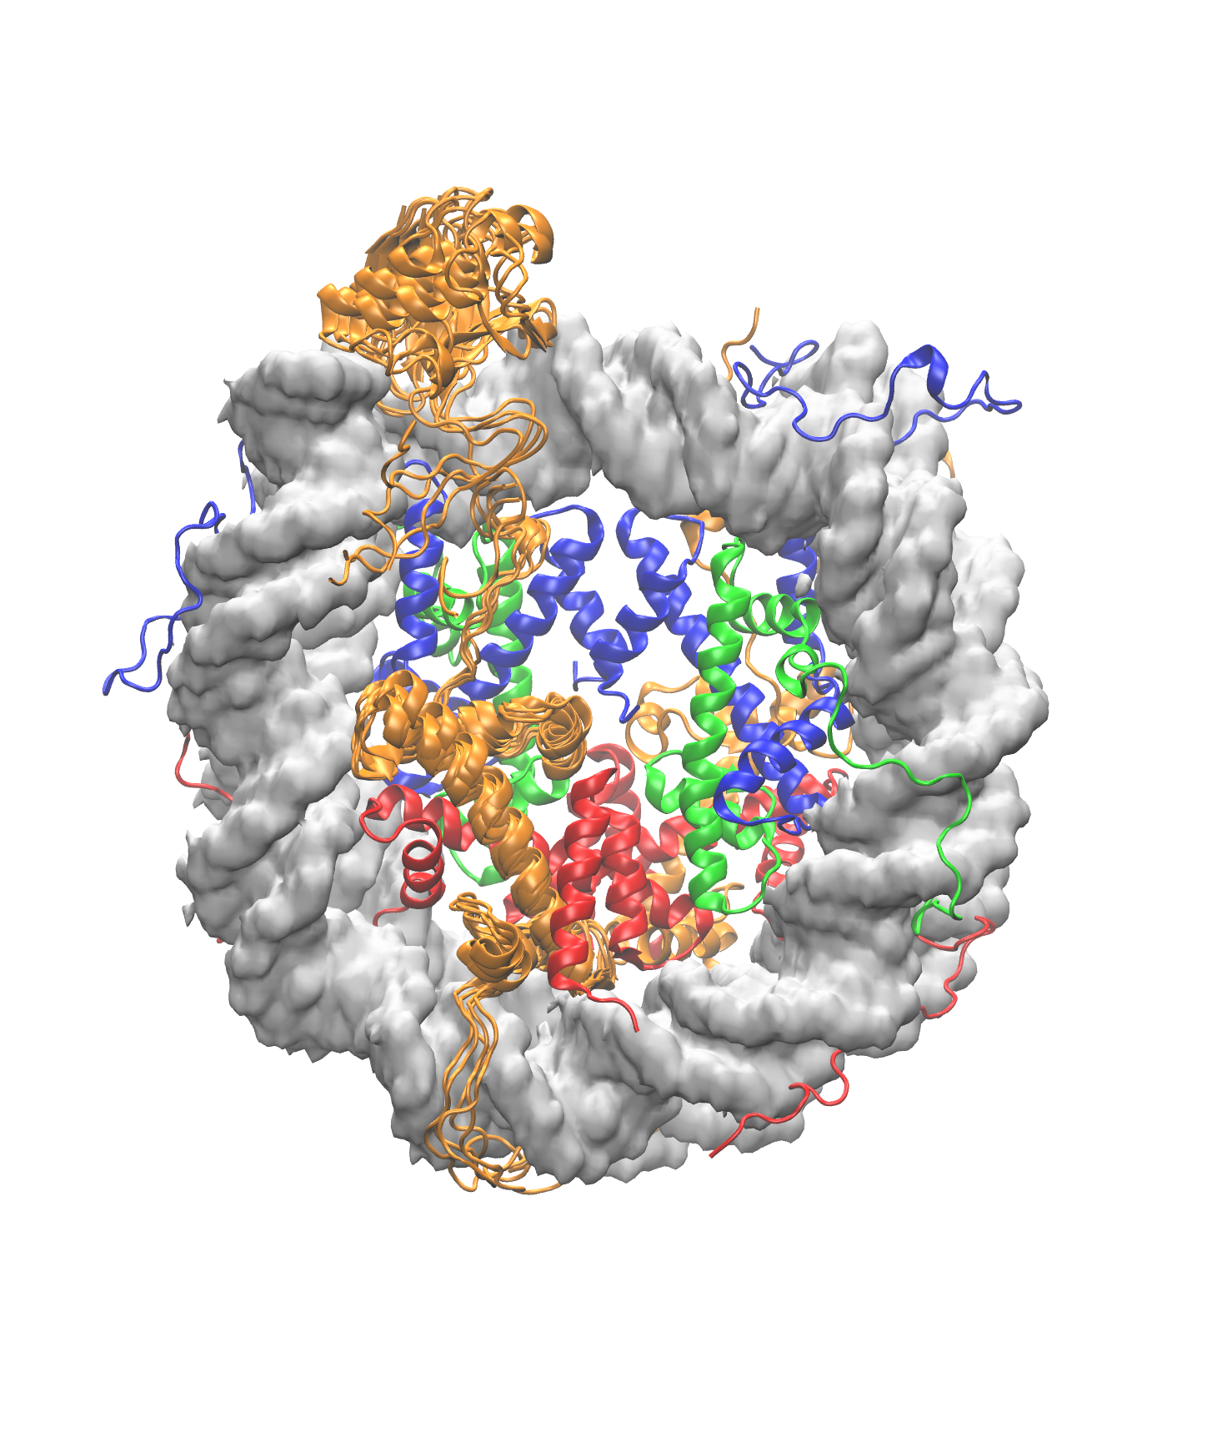
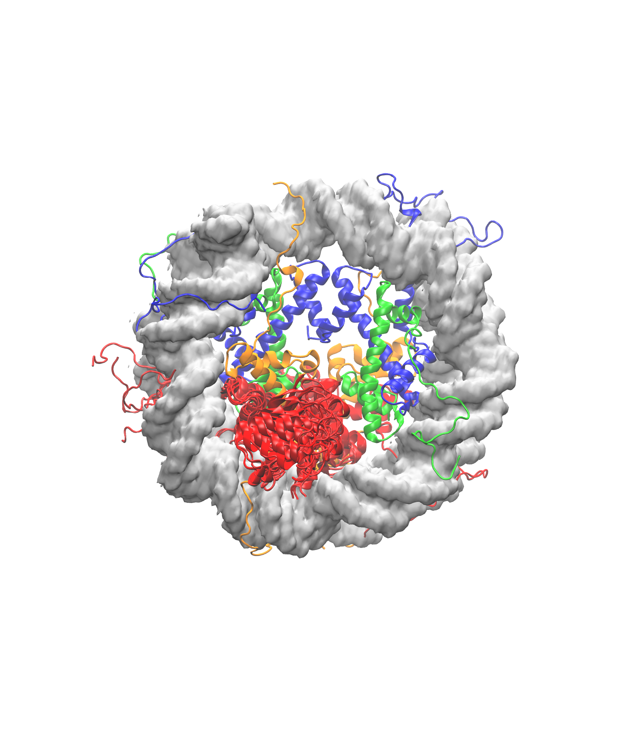
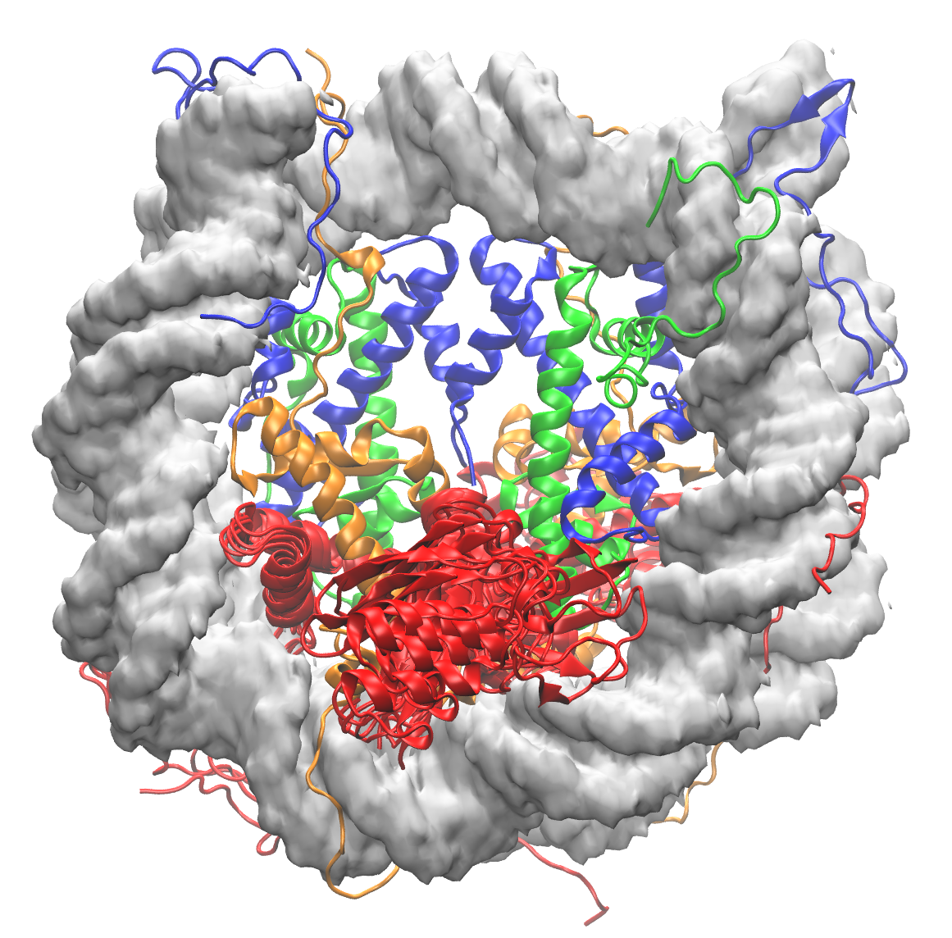
H2AK119ub
H2BK120ub
180°

Slide 8
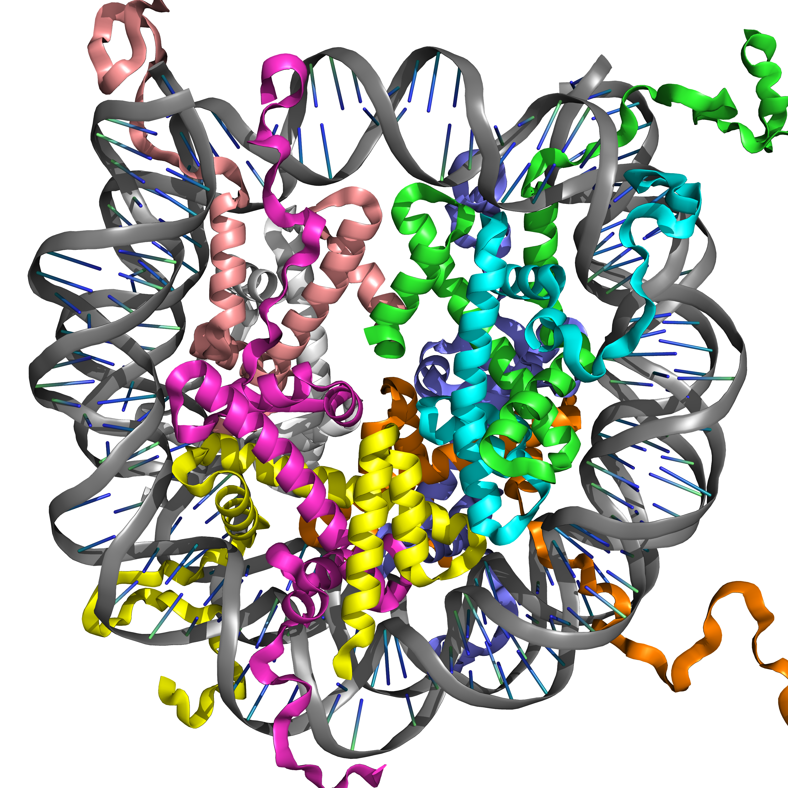
Dyad axis
H2A axis

Slide 9
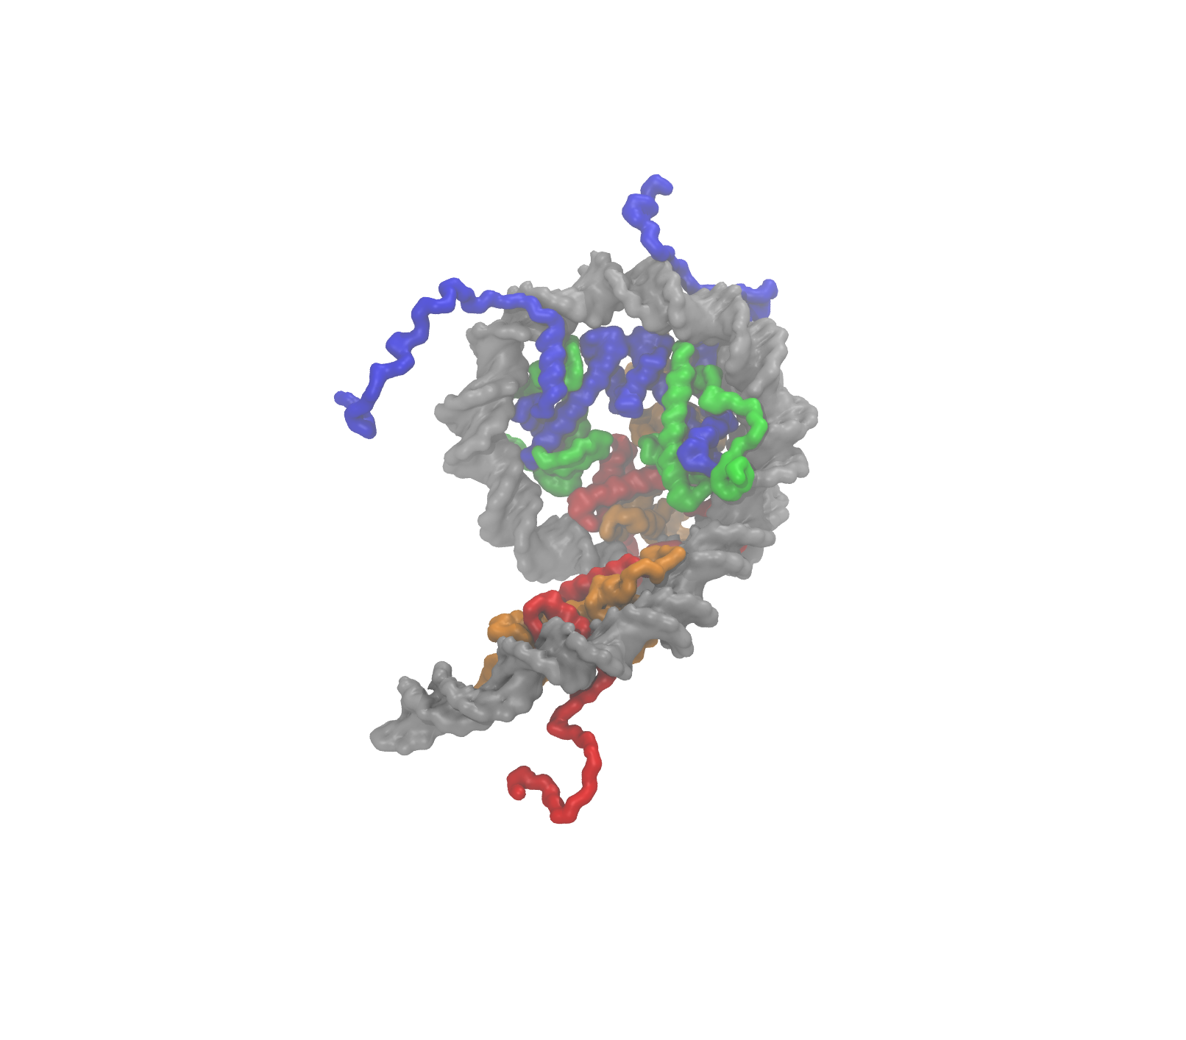
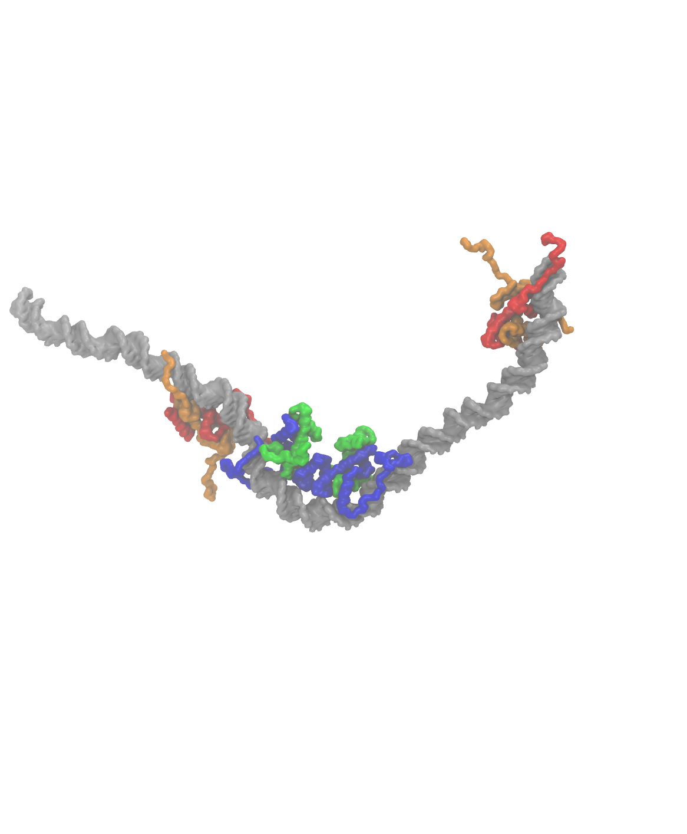
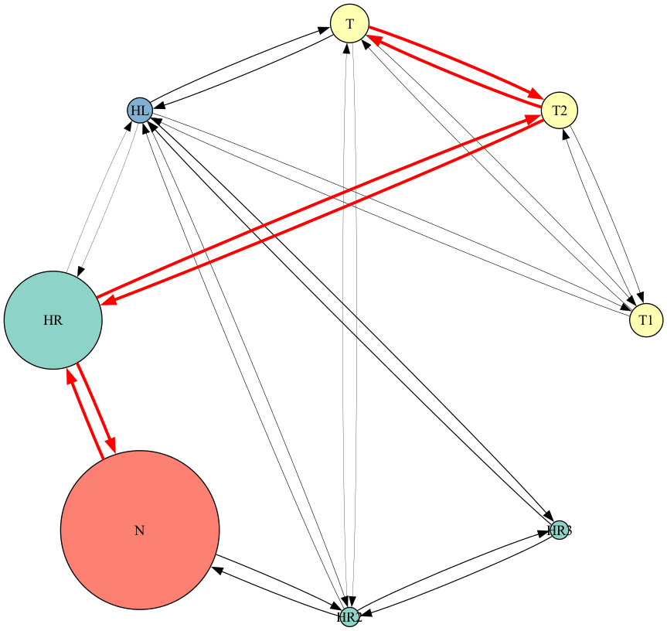
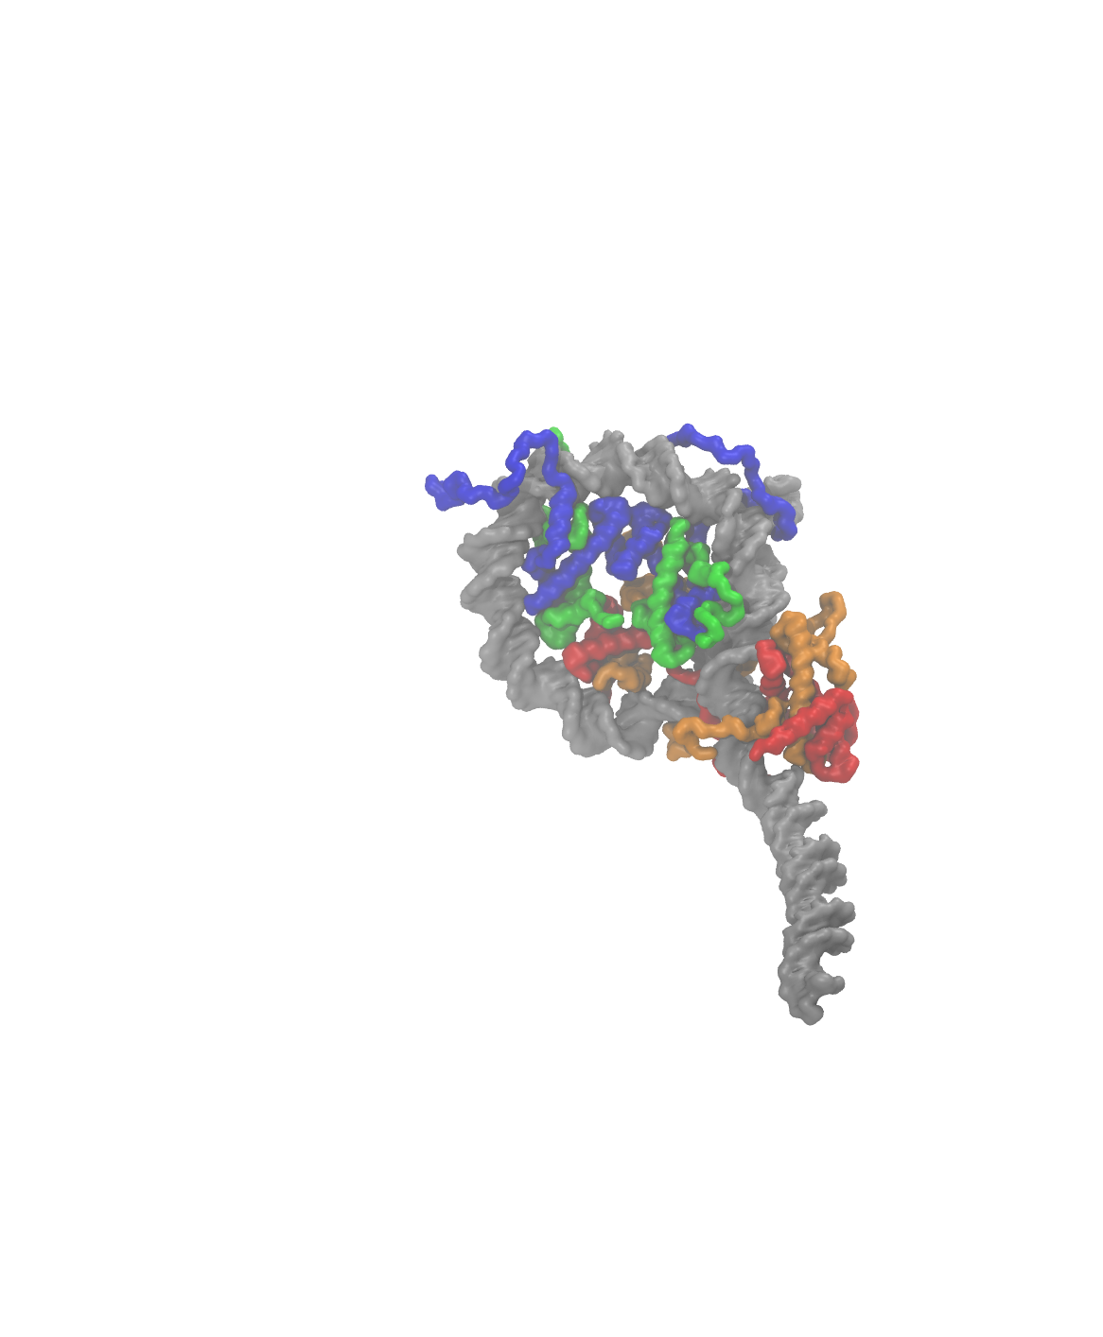
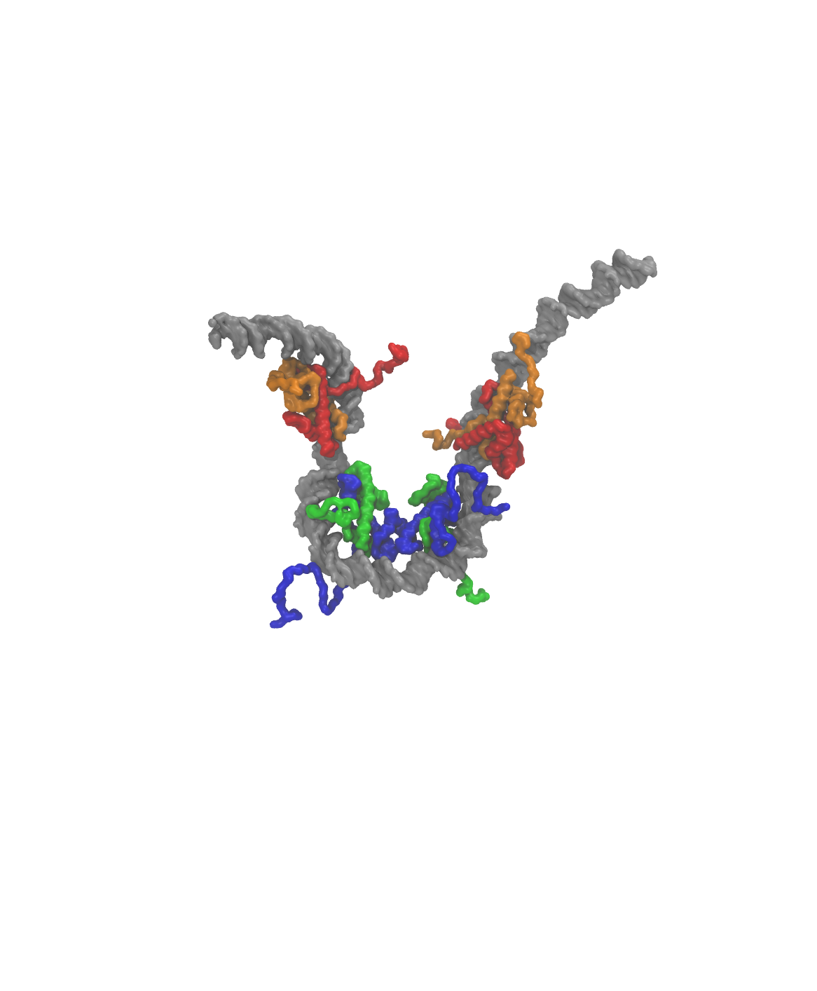
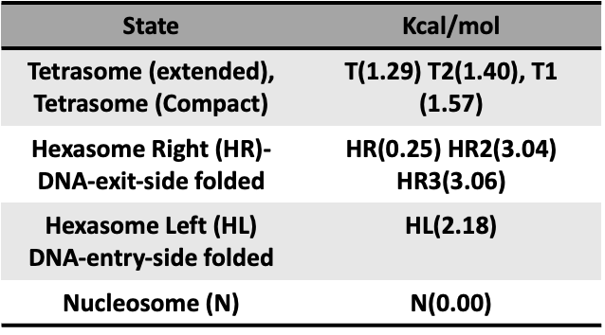
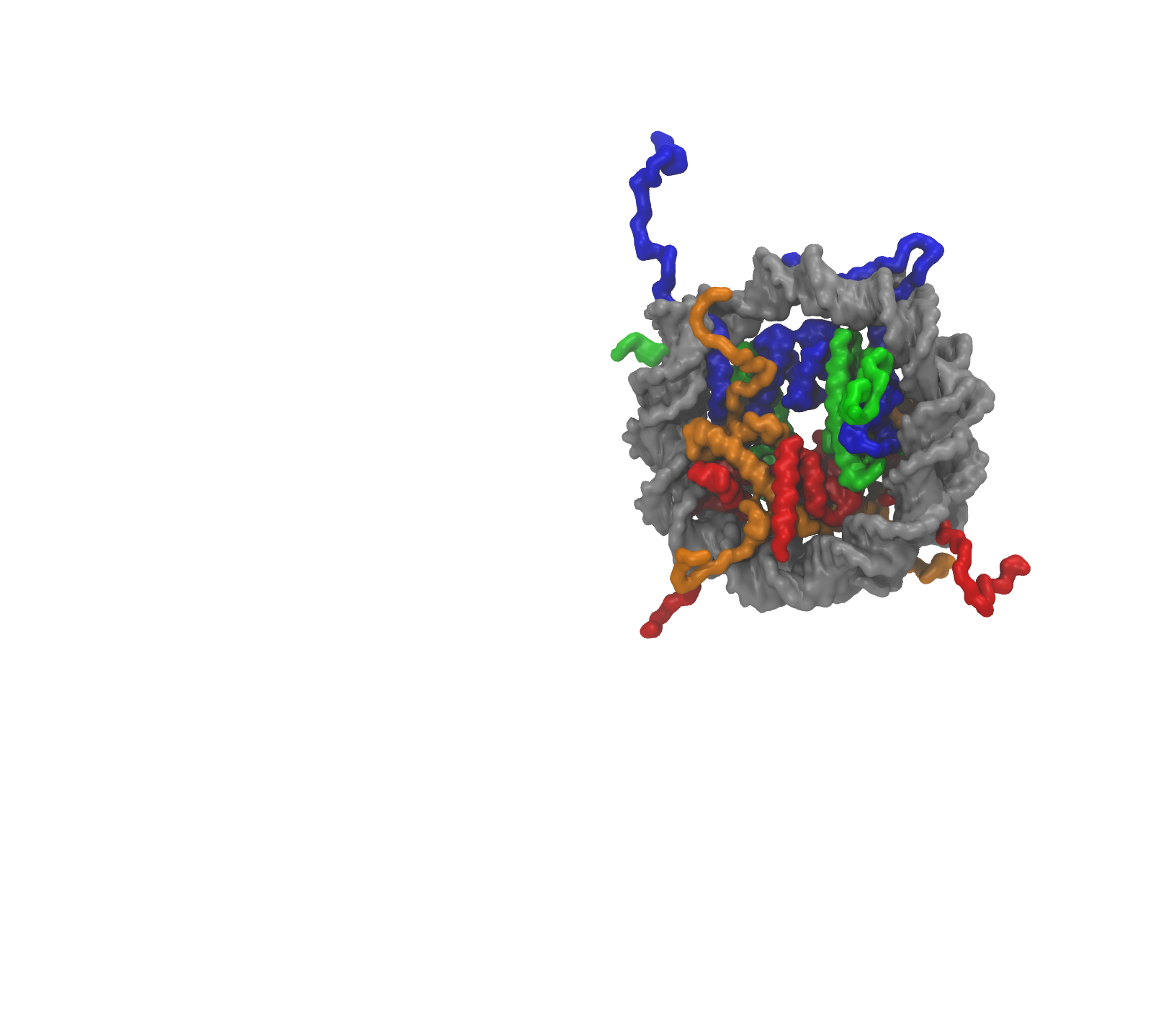
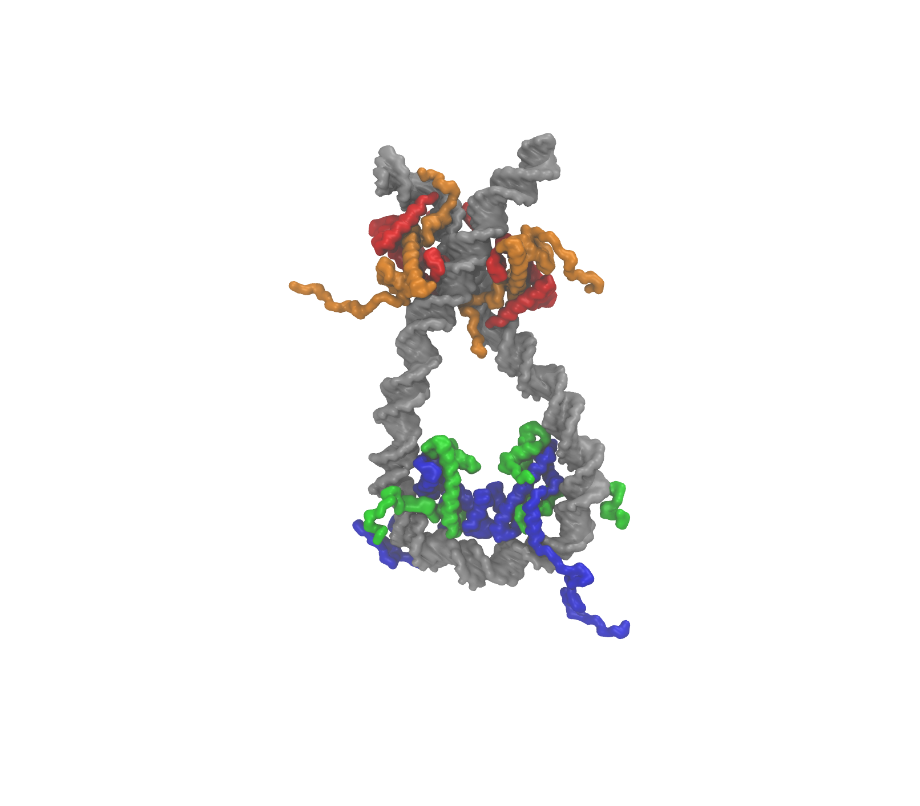
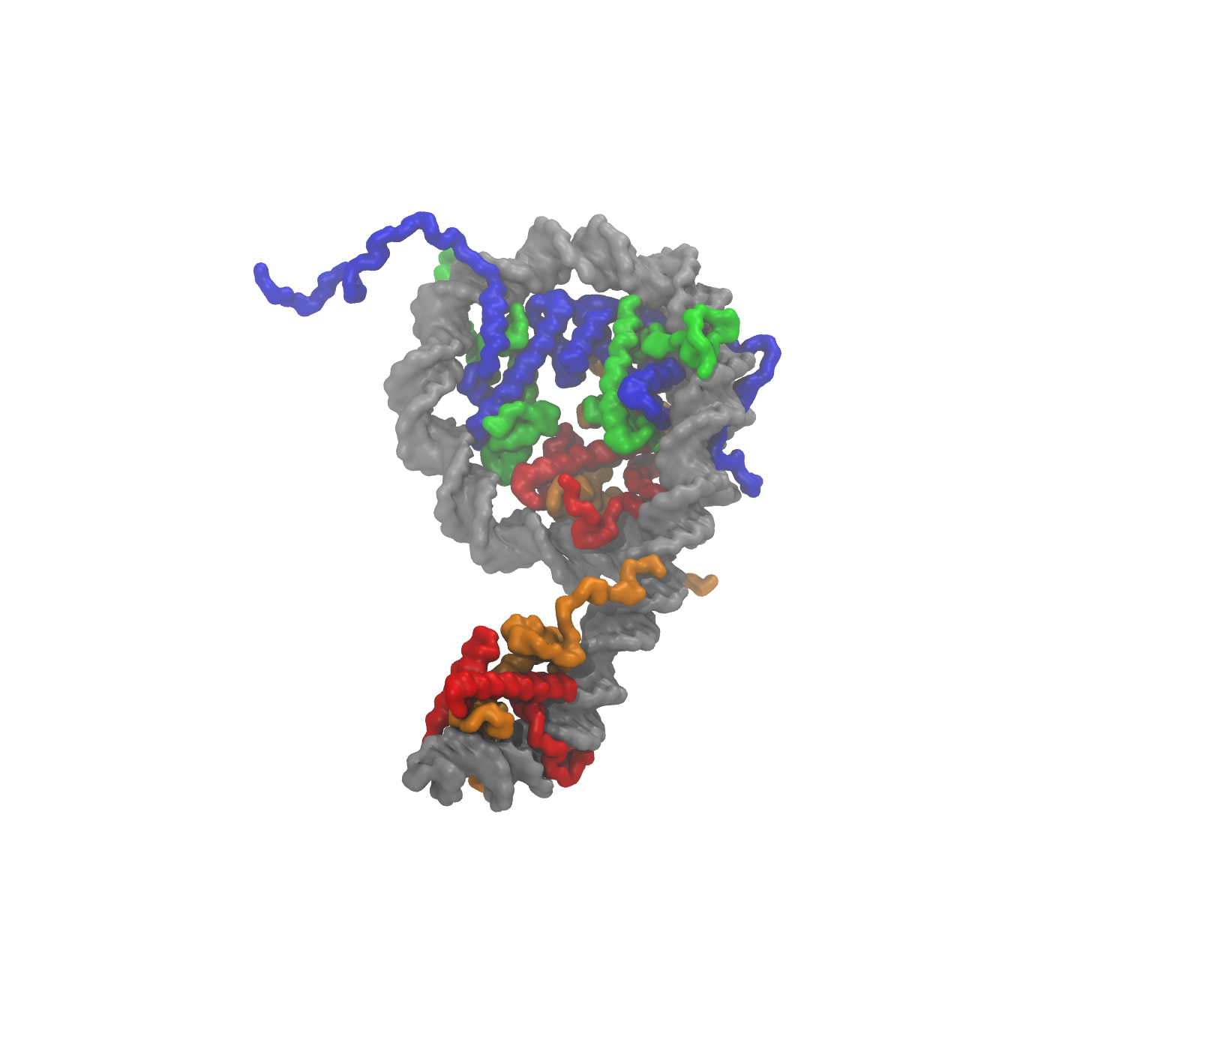
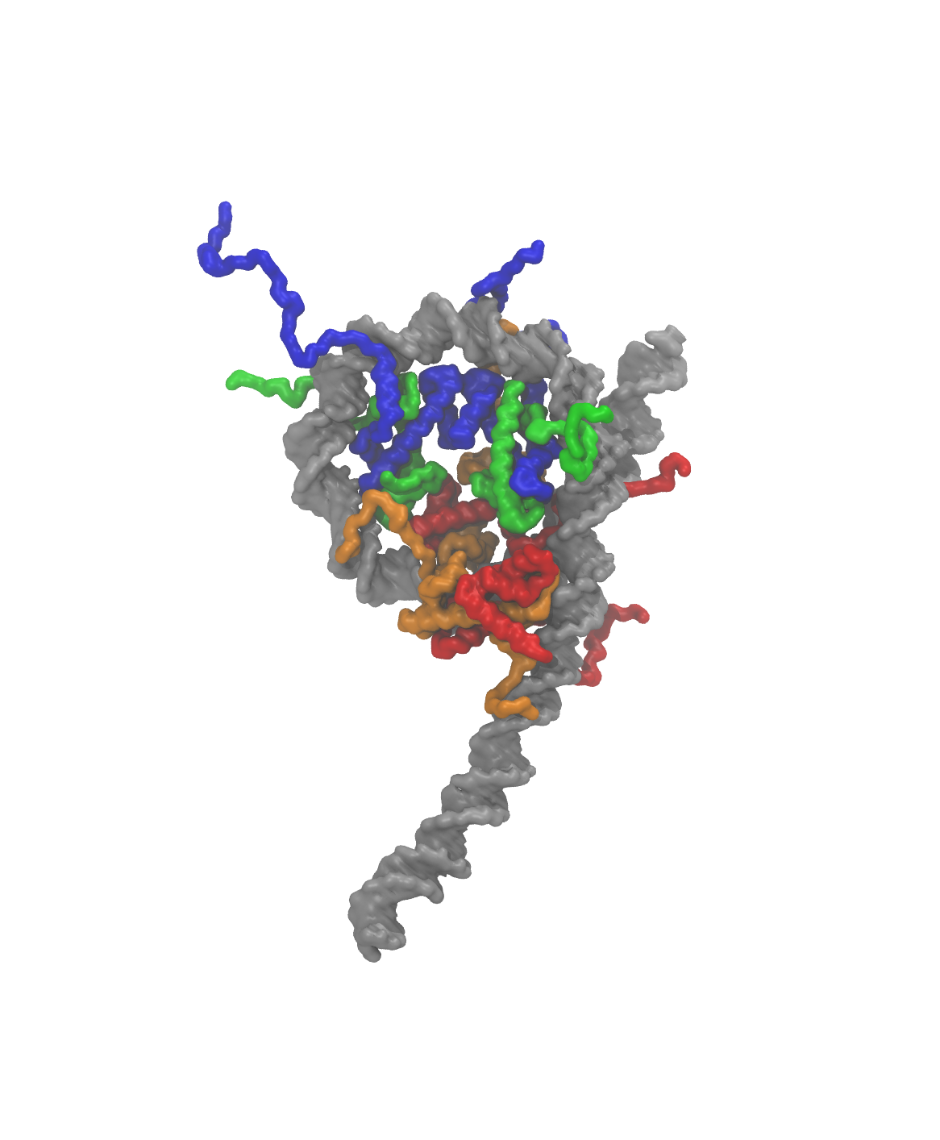

Slide 10
